Slide 1
First STEM Consortium Meeting
October 28, 2016

Slide 2
Agenda
Brief presentations of the research and work going on at each institution
Time to meet each other in different interest groupings
Group discussion of future plans
More time to chat and discuss future plans

Slide 3

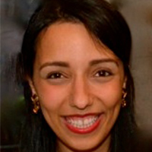
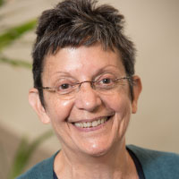
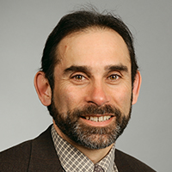
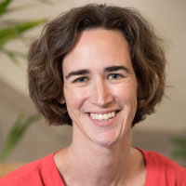
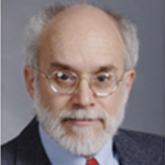
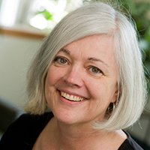
What’s going on at BU?
City Lab
Don DeRosa
(Science)
Nermeen Dashoush
(Early Childhood)
Beth Warren
(Literacy)
Mission Earth
ArtScience
Eve Manz
(Science)
Classroom Talk
Elementary Science Investigations
Peter Garik
(Science)
Cathy O’Connor
(Language)
Notes:
Mission Earth: Supporting students to collect real-time weather data to understand weather systems. Developing a learning progression to understand how elementary students develop ideas and practices related to use of data to understand weather.
Cathy: Has contributed to our understanding of how talk positions students in math and science classrooms; teaches discourse analysis classes that students across BU, BC, and Tufts have attended.
Me: Opening up elementary science investigations to support more authentic participation in science practices
Beth: Works with collaborators at TERC on a design study to leverage thinking practices used in art and science to help high school students from communities typically underrepresented in STEM fields make sense of complex issues; namely climate change and the human microbiome.
Nermeen: supports our students in early childhood and preschool/early elementary teachers to …

Slide 4
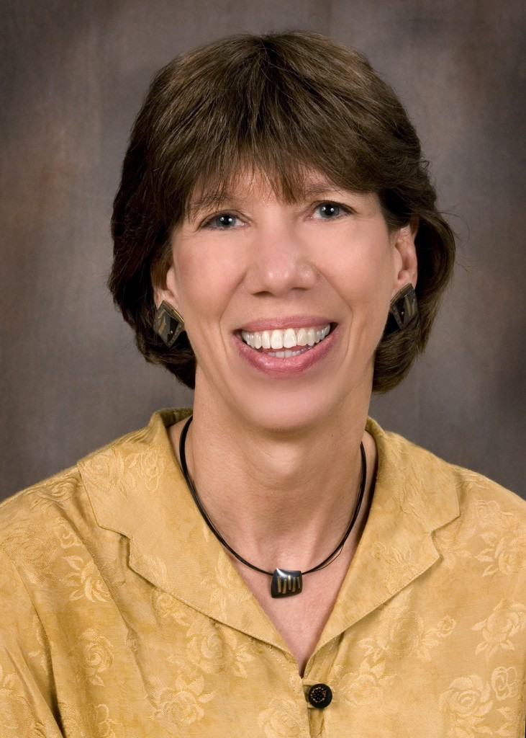
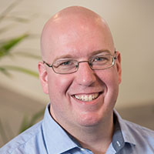
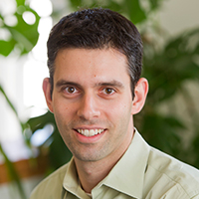
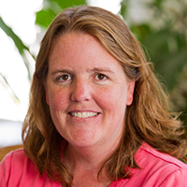
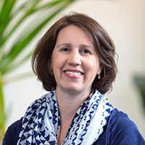
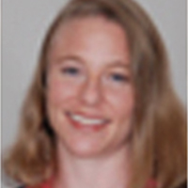
What’s going on at BU?
EPIC
EMP
Aaron Brakoniecki
(Math)
Ziv Feldman
(Math)
Suzanne Chapin
(Math)
Alejandra Salinas
(Math)
Leslie Dietiker
(Math)
Expanded Learning through Transmedia Content
Lynsey Gibbons
(Math)
Job-embedded Math PD
Notes:
EMP: Designing and testing content courses that help elementary pre-service teachers develop a deep understanding of mathematics content and approaches to mathematical sense-making. Testing how the course works in universities across the country.
EPIC: Considering how expert teachers draw from textbooks and use them to create meaningful experiences for learners
Expanded Learning through Transmedia Content: Provides guidance to early elementary teachers to use games and tv shows to support mathematics and science learning
Lynsey: Developing and investigating school structures that support teachers to improve mathematics teaching; investigates the role of the principal and coach in these efforts.

Slide 5
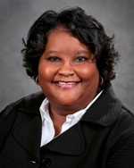
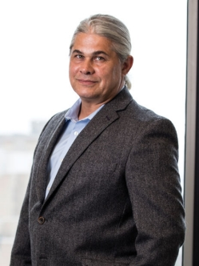
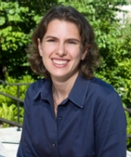
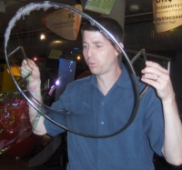
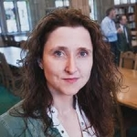
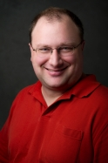
What’s going on at BC?
Dr. Lillie Albert
(Social contexts & Mathematics teaching and learning)
Dr. Jim Slotta
(Learning Sciences)
Dr. Kate McNeill
(Science Education – science practices & learning environments)
Dr. Mike Barnett
(science education & technology)
Dr. Laura O’Dwyer
(Quantitative issues in math and science)
Dr. Nathaniel Brown
(student assessments in science)
Notes:
Mike – hydroponics
ERME = Educational Research, Measurement and Evaluation
Laura – quantiative methods issues in math and science. DRK12 with folks at EDC around supporting success in algebra
Nathaniel – student assessment issues in science. Currently working with folks at TERC on 2 NSF projects developing 2D assessments – science practices and content

Slide 6
Science, Technology, Engineering and Mathematics Education
M.S. & Ph.D.
Research on learning and instruction in mathematics, engineering and science, K-16.
Emphasis throughout on contact with the disciplines and their practices.
Collaborations with STEM departments, the Center for Engineering Education and Outreach (CEEO), and other programs in Education.

Slide 7
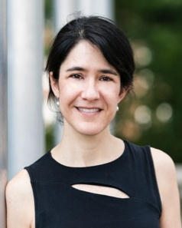
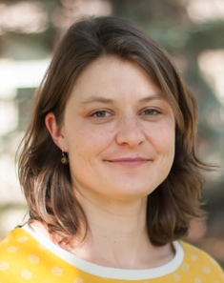
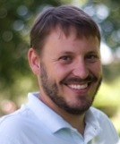
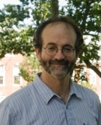
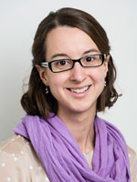
Core Faculty
Bárbara
Brizuela
Julia
Gouvea
Brian
Gravel
David
Hammer
Kristen Bethke
Wendell

Slide 8

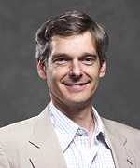
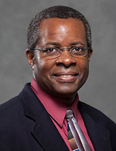
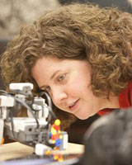
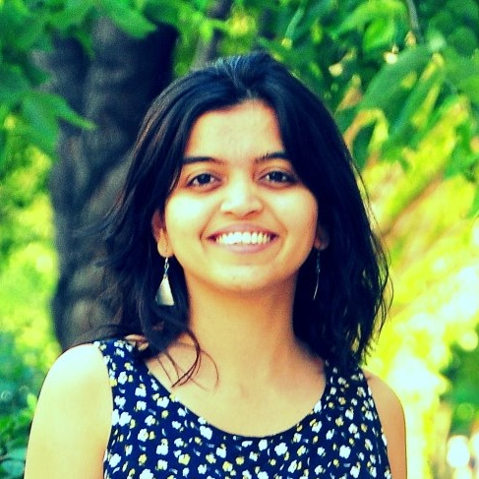
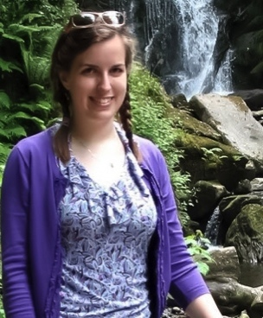
Adjunct Faculty & Researchers
Cindy Ballenger,
CD
Chris Rogers, CEEO
Chris Swan,
Engineering
Merredith Portsmore,
CEEO
Aditi Wagh,
Postdoctoral
Fellow
Jessica Watkins, Research Asst.
Professor

Slide 9
Active Research Projects
SiMSAM
Dynamics of Engagement and Persistence in Science
Novel Engineering
Nedlam’s Workshop
Play, Making, Schooling – LEGO Foundation
STEMLiMS – STEM Literacies in Makerspaces
Modeling in Biology
CodeR4Stats
Community-Based Engineering
Engineering discourse supports – digital design notebooks
Responsive Teaching in Engineering
Poincaré Institute
Noyce Project
Early Algebra

Slide 10
Ongoing Events of Interest

